Slide 1
Access Control Lists
By: Arnav Kadam

Slide 2
What are access control lists?
Examples of Uses:
Limit Network traffic to increase network performance
Provide traffic flow control
Provide basic level of security for network access
Filter traffic based on type
Series of IOS commands used for packet filtration
Uses information located in packet header
ACL’s use ACE’s → Access Control Entries
Sequential lists of permit and deny statements

Slide 3
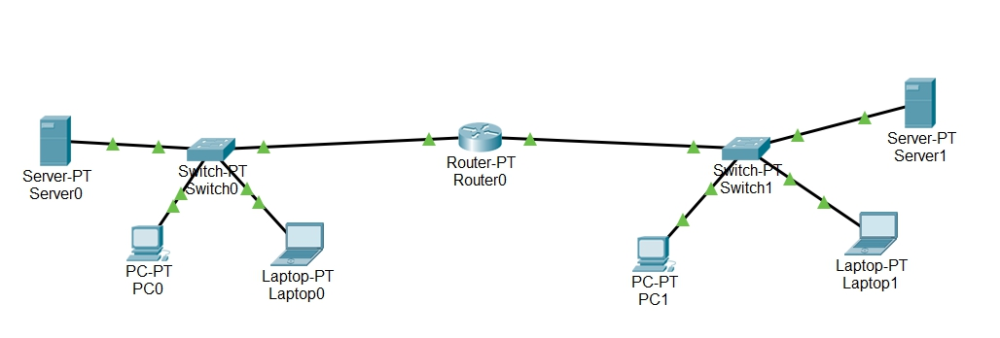

Slide 4
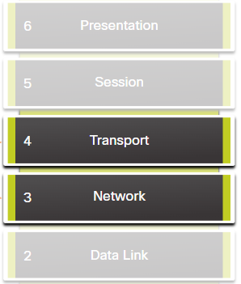
Packet Filtering
Packet Filtering controls access to a network
Either forwards or discards incoming packets
Occurs at Layer 3 or Layer 4 in the OSI model
Open Systems Interconnection

Slide 5
Standard ACLs VS Extended ACLs
Only filter at Layer 3 of the OSI Model
Use only the source IPv4 Address
Less useful than extended
access-list 10 permit 192.168.10.0 0.0.0.255
Filters at Layer 3 or Layer 4 of OSI
Can use both the source and destination ip address
Allow for port specifications
access-list 100 permit tcp 192.168.10.0 0.0.0.255 any eq www

Slide 6
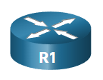
ACL Operation
Router extract source ip address
Starts at the top, and compares source address to each ACE
If there is a match, the router follows the instructions of the ACL
If no match is made, the packet is discarded
Inbound ACL
Router → R1
Outbound ACL

Slide 7
Wildcard Mask
IPv4 Address Structure → 192.168.10.0 11000000.10101000.00001010.00000000
Wildcard Mask → 0.0.0.255 00000000.00000000.00000000.11111111
See which bits correspond to the 0’s in the Wildcard Mask.
Important
11000000.10101000.00001010
00000000
Unimportant

Slide 8
Configure Standard ACLs
Structure: Router(config)# access-list access-list-number { deny | permit | remark } source [ source-wildcard ][ log ]
Example: Router (config) # access-list 10 permit 192.168.10.0 0.0.0.255
What it does: ACL 10 permits hosts on the source network 192.168.10.0/24.
Example: Router (config) # access-list 2 deny 192.168.0.0 0.0.255.255
What it does: ACL 2 denies hosts from the source network 192.168.10.0/16

Slide 9
Configure Standard ACLs
Keywords: “host” → 0.0.0.0 and “any” → 255.255.255.255
“permit host 192.168.10.10” is the same as “permit 192.168.10.10 0.0.0.0”
One an ACL is made, it must be configured to an inbound or outbound interface:
Router(config-if)# ip access-group { access-list-number | access-list-name } { in | out }
Example: Router(config) # access-list 10 permit 192.168.10.0 0.0.0.255
Router(config-if) # ip access-group 10 in or ip access-group 10 out

Slide 10
Configure Extended ACLs
Structure: Router(config)# access-list access-list-number {deny | permit | remark text} protocol source source-wildcard [operator {port}] destination destination-wildcard [operator {port}] [established] [log]
Example: Router (config) # access-list 111 permit tcp 192.168.150.0 0.0.0.255 host 66.66.66.66 eq www
What it does: ACL 111 permits tcp traffic from the source network 192.168.150.0/24 that are headed to the host address 66.66.66.66 through port 80 (www).

Slide 11
Lets Practice!
Quiz : 5 Questions

Slide 12
Question 1:
What does ACE stand for?
Access Control Entries

Slide 13
Question 2:
What are two differences between standard and extended ACLs?
Standard ACL’s only filter using source ip address, while extended also filter using the destination ip address.
Standard ACL’s filter at Layer 3 of the OSI Model, while extended filter at both Layer 3 and Layer 4.

Slide 14
Question 3:
Which source ip address would be permitted based off this standard ACL?
Router (config) # access-list 6 permit 192.43.21.33 0.0.255.255
192.168.33.42
192.43.12.10
168.60.47.0
192.158.1.38

Slide 15
Question 4:
Which statements makes an extended ACL that denies packets with the host address 74.96.218.90 and destination address 192.168.10.0 through port 72?
access-list 10 permit host 74.96.218.90 192.168.10.0 0.0.255.255 eq 72
access-list 10 deny host 74.96.218.90 host 192.168.10.0 eq 68
access-list 10 deny host 74.96.218.90 host 192.168.10.0 eq 72
access-list 10 permit host 74.96.218.90 any gt 34

Slide 16
Question 5:
Which commands applies Access-list 10 to the outbound interface?
ip access-group 10 out
ip access-group 10 in
ip access-list in 10
out access-list 10

Slide 17
THANKS!
Any questions?

